Slide 1






Gradient color from left to right
NH Registration Auto screens
Leave as is
The Human Hub … Transforming Relationships

Slide 2


Slide 4


Slide 5
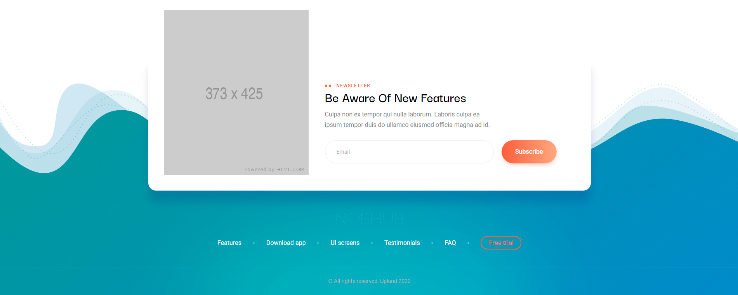

Slide 6
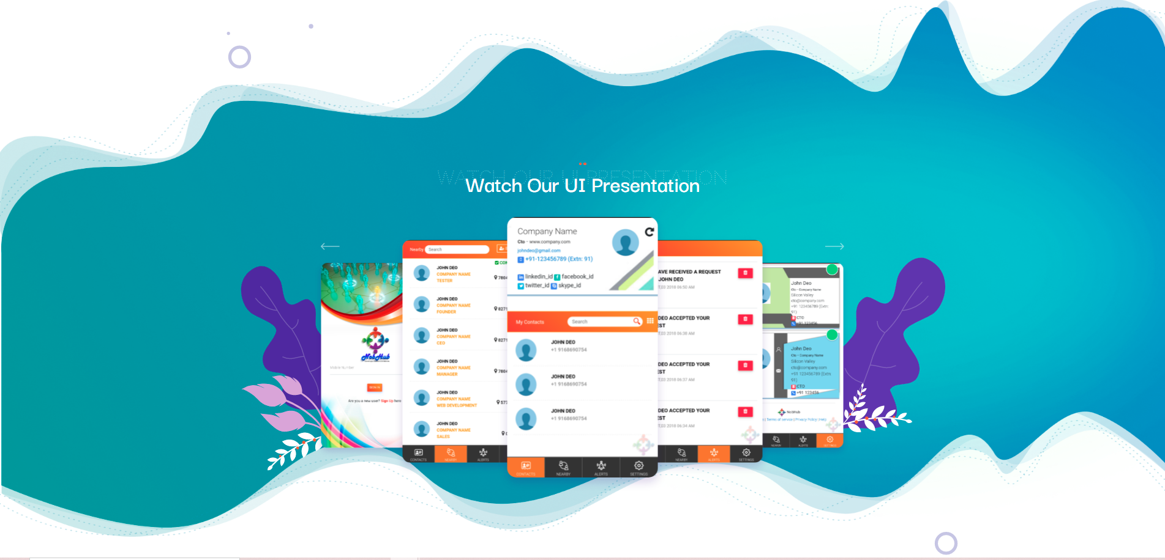

Slide 7
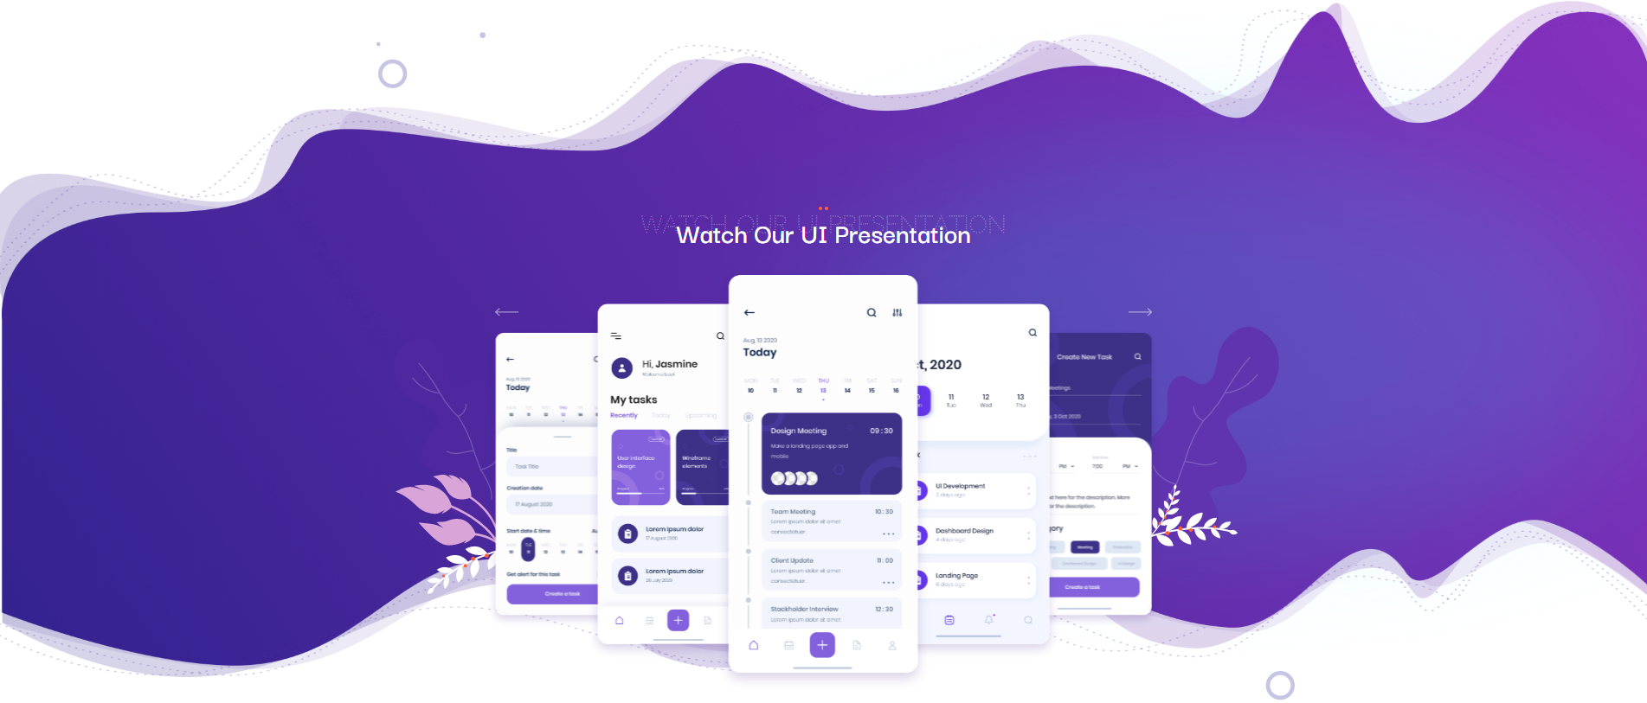

Slide 8


Slide 9


